Slide 1
HW1P1 Bootcamp An Introduction to Neural Networks FALL 2021
TAs: Omisa Jinsi, Xiang Li, Fan Zhou

Slide 2
Homework 1 Part 1 Bootcamp
Forward:
Linear
Batch Norm
Activation
Loss
Backward:
(1) Loss
Activation
Batch Norm
Linear
Gradient Descent

Slide 3
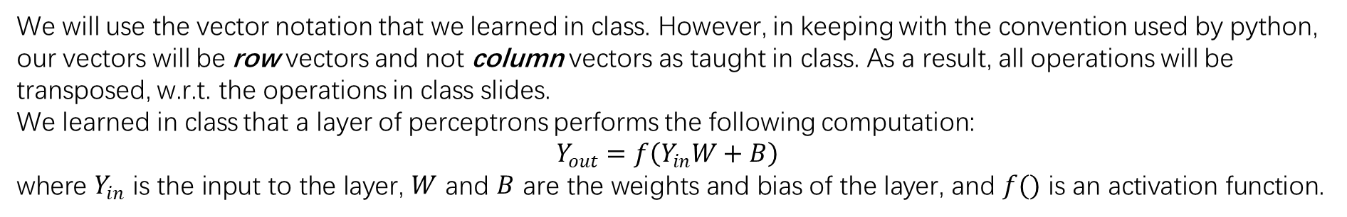
Hint
DO NOT:
– Import any other external libraries other than numpy, as extra packages that do not exist in autolab will cause submission failures.
– Add, move, or remove any files or change any file names.
MULTIPLE CHOICE
These questions are intended to give you major hints throughout the homework. Please try to thoroughly understand the questions and answers for each one. Each question has only a single correct answer. (*HINT: You can try to code some questions and verify your answers.)
PYTHON VECTOR REPRESENT
We will use the vector notation that we learned in class. However, in keeping with the convention used by python, our vectors will be row vectors and not column vectors as taught in class. As a result, all operations will be transposed, w.r.t. the operations in class slides.
We learned in class that a layer of perceptrons performs the following computation:
$$Y_{out}=f\left(Y_{in}W+B\right)$$
where $Y_{in}$ is the input to the layer, $W$ and $B$ are the weights and bias of the layer, and $f()$ is an activation function.

Slide 4
FORWARD
x
z
z_norm
Batch Normalization
Activation
y
Linear Layer
d
Loss Function
BACKWARD
L (loss)
dL/ dz_norm
Derivative
dL/ dx
dL/ dz
Linear Layer
Batch Normalization
Activation
dL/dy

Slide 5
Consider object-oriented programming ideas …
Linear Layer
Batch Normalization
Activations
Loss
x
z
z_norm
forward
forward
forward
y
d
forward
L (loss)
dL/ dz_norm
derivative
dL/ dx
dL/ dz
backward
backward
backward
dL/dy

Slide 6
MyTorch
• mytorch
Linear Layer
– linear.py
Batch Normalization
– batchnorm.py
Activations
– activation.py
Loss
– loss.py
Notes:
From the linear formula above, we can see that in actual code, the calculation of a single linear layer is composed of two steps:
The first step is the dot product between the input variable x and the weight w, which can be done using np.dot or np.matmul.
The second step is the sum of their dot product results and the bias b.

Slide 7
MyTorch
• mytorch
– linear.py
– batchnorm.py
– activation.py
– loss.py
• hw1
– hw1.py
Linear Layer
Batch Normalization
MLP
Activations
Loss
Notes:
From the linear formula above, we can see that in actual code, the calculation of a single linear layer is composed of two steps:
The first step is the dot product between the input variable x and the weight w, which can be done using np.dot or np.matmul.
The second step is the sum of their dot product results and the bias b.

Slide 8
MyTorch
• mytorch
– linear.py
– batchnorm.py
– activation.py
– loss.py
• hw1
– hw1.py
• autograder
– hw1_autograder
∗ runner.py
∗ test.py
• toyproblem
– toy.py
– Toyproblem.pdf
• expected_graphs
– train_error.png
– train_loss.png
– val_error.png
– val_loss.png
• create_tarball.sh
Linear Layer
Batch Normalization
Activations
MLP
Loss
Notes:
From the linear formula above, we can see that in actual code, the calculation of a single linear layer is composed of two steps:
The first step is the dot product between the input variable x and the weight w, which can be done using np.dot or np.matmul.
The second step is the sum of their dot product results and the bias b.

Slide 9
FORWARD
Linear Layer
Batch Normalization
Activations
Loss
x
z
z_norm
forward
forward
forward
y
d
forward
L (loss)
dL/ dz_norm
derivative
dL/ dx
dL/ dz
backward
backward
backward
dL/dy
BACKWARD

Slide 10
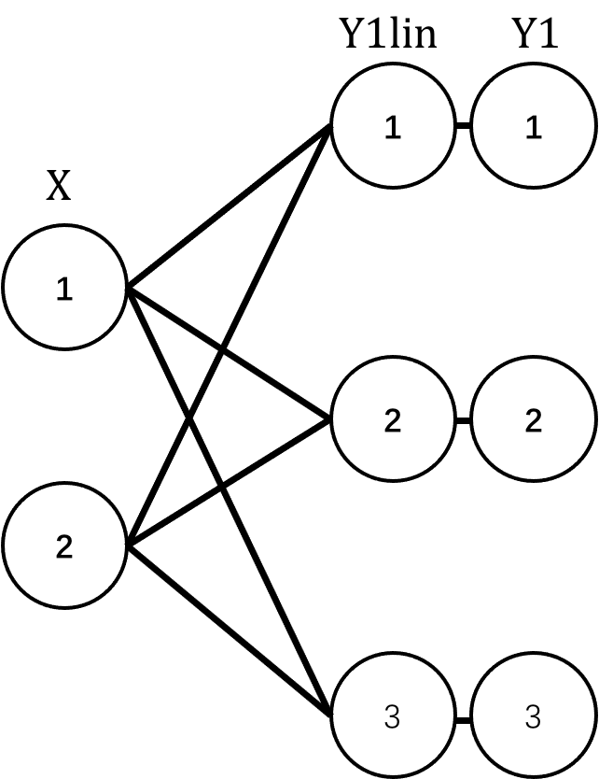

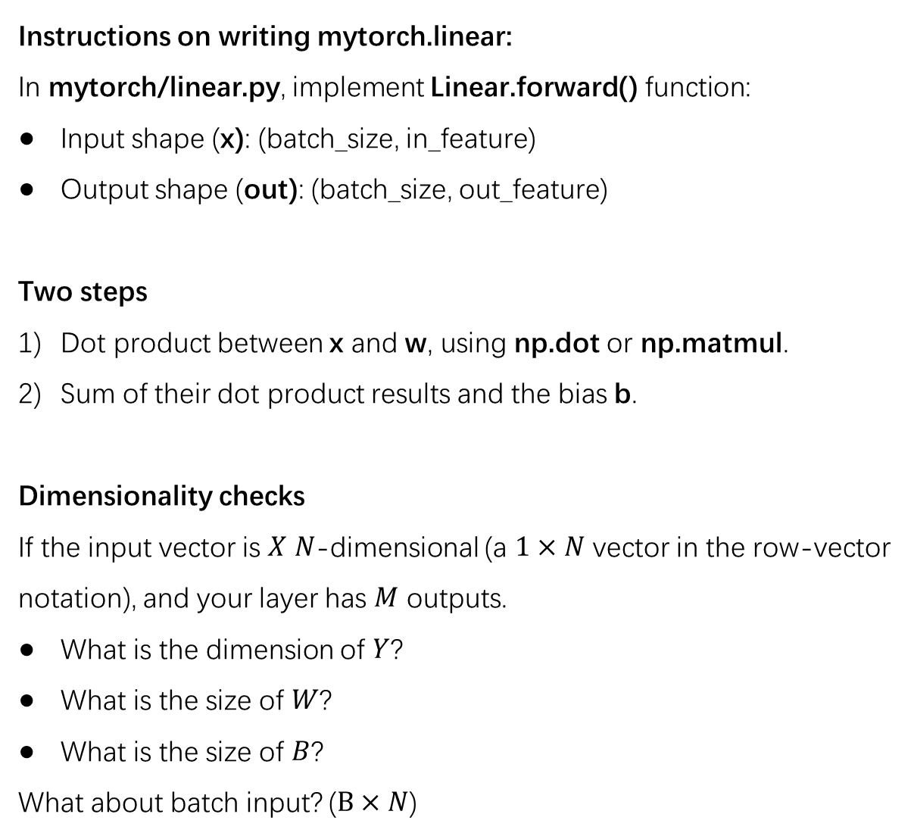
MLP Forward
Instructions on writing mytorch.linear:
In mytorch/linear.py, implement Linear.forward() function:
Input shape (x): (batch_size, in_feature)
Output shape (out): (batch_size, out_feature)
Two steps
Dot product between x and w, using np.dot or np.matmul.
Sum of their dot product results and the bias b.
Dimensionality checks
If the input vector is $X$ $N$-dimensional (a $1×N$ vector in the row-vector notation), and your layer has $M$ outputs.
What is the dimension of $Y$?
What is the size of $W$?
What is the size of $B$?
What about batch input? ($B×N$)
Implementing a linear layer
$$Y=XW+B$$
Notes:
From the linear formula above, we can see that in actual code, the calculation of a single linear layer is composed of two steps:
The first step is the dot product between the input variable x and the weight w, which can be done using np.dot or np.matmul.
The second step is the sum of their dot product results and the bias b.

Slide 11
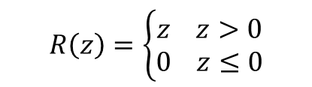







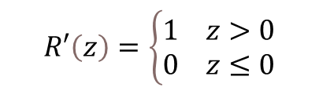
MLP Forward
Implementing an activation layer
$$Y_{out}=f\left(Y_{in}\right)$$
$S(z)=\frac{1}{1+e^{−Z}}$
Sigmoid Forward
$$S^{′}\left(z\right)=S\left(z\right)⋅\left(1−S\left(z\right)\right)$$
Derivative
$tanh(z)=\frac{e^{z}−e^{−z}}{e^{z}+e^{−Z}}$
2) Tanh Forward
$$tanh^{′}(z)=1−{tanh(z)}^{2}$$
Derivative
$$R\left(z\right)=\left\{\begin{aligned}z z>0 \\ 0 z≤0\end{aligned}\right.$$
3) ReLU Forward
$$R′\left(z\right)=\left\{\begin{aligned}&1 z>0 \\ &0 z≤0\end{aligned}\right.$$
Derivative
$$σ(z_{i})=\frac{e^{z_{j}}}{\sum_{k=1}^{K}{e^{z_{k}}}} for j=1, …, K$$
4)* Softmax Forward
$$σ_{i}′\left(z_{j}\right) =\left\{\begin{aligned}−σ_{i}\left(z_{i}\right)σ_{i}\left(z_{j}\right) i≠j \\ σ_{i}\left(z_{i}\right)(1−σ_{i}\left(z_{j}\right)) i=j\end{aligned}\right.$$
Derivative

Slide 12
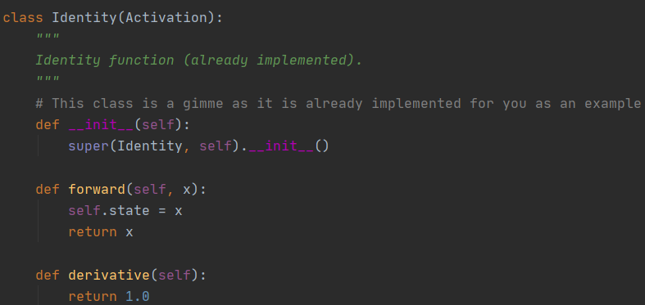
MLP Forward
Instructions on writing mytorch.activation:
In mytorch/activation.py, implement the forward function for each activation class. And we also show the way to calculate the derivative during the backward pass.
The identity has been implemented for you as an example.
The output of the activation should be stored in the state.
The state variable should be used for calculating the derivative during the backward pass.
Implementing an activation layer
$$Y_{out}=f\left(Y_{in}\right)$$

Slide 13
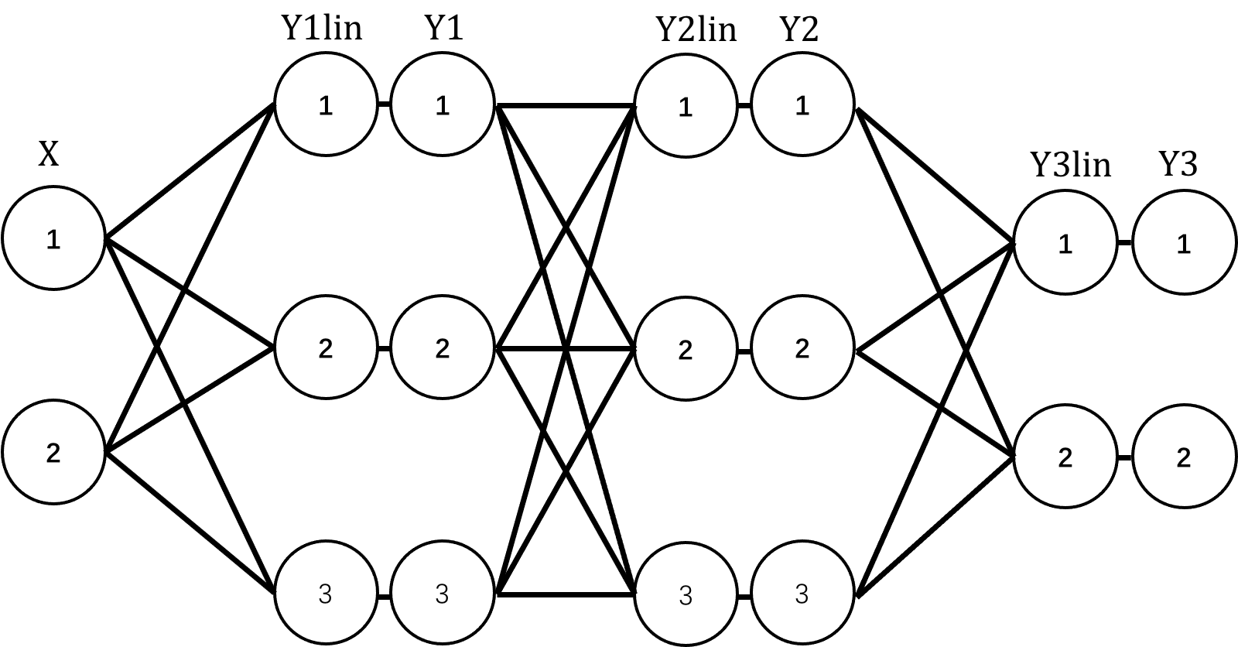
MLP Forward
Implementing a complete MLP
Y1lin = linear1.forward(X) Y1 = relu1.forward(Y1lin)
Y2lin = linear2.forward(Y1) Y2 = relu2.forward(Y2lin)
Y3lin = linear3.forward(Y2) Y3 = softmax.forward(Y3lin)

Slide 14
MLP Forward
Instructions on writing hw1.hw1:
In hw1/hw1.py, implement the forward function for MLP
Store all your layers in a list (linear_layers).
In addition, a similar initialization can be done for the BN layer (BN_layers).
Loop over the hidden layers to pass forward
Terminology: The outputs of the final linear layer (i.e. YlinFinal) are often called the logits. You will encounter this term frequently.
Implementing a complete MLP
Y = X for layer = 1:num_hidden_layers Ylin = LinerLayers[layer].forward(Y) Y = ActivationLayers[layer].forward(Ylin) end
# The output layer immediately follows the hidden layers YlinFinal = LinerLayers[-1].forward(Y) Yout = softmax.forward(Ylin)

Slide 15
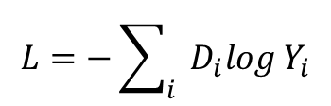
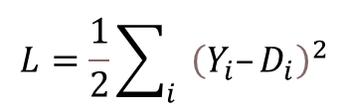
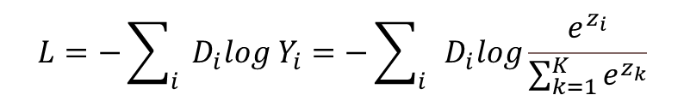
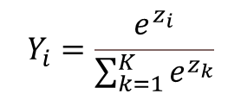
Computing the Loss
The loss quantifies the discrepancy between the actual output of a network $Y$, and the target output $D$, and is typically computed on training inputs, for which both the input $X$ and the target output
$$L = loss(Y, D)$$
Concept implementation
L2 Loss
Cross-Entropy Loss
3)* Softmax Cross-Entropy Loss
$$L=\frac{1}{2}\sum_{i}{{\left(Y_{i}–D_{i}\right)}^{2}}$$
L = L2.forward(Y, D)
$$L=−\sum_{i}{D_{i}log Y_{i}}$$
CE Loss is not calculated separately during implementation
$$Y_{i}=\frac{e^{z_{i}}}{\sum_{k=1}^{K}{e^{z_{k}}}}$$
L = SoftmaxCrossEntropy.forward(Y, D)
$$L=−\sum_{i}{D_{i}log Y_{i}}=−\sum_{i}{D_{i}log\frac{e^{z_{i}}}{\sum_{k=1}^{K}{e^{z_{k}}}}}$$

Slide 16
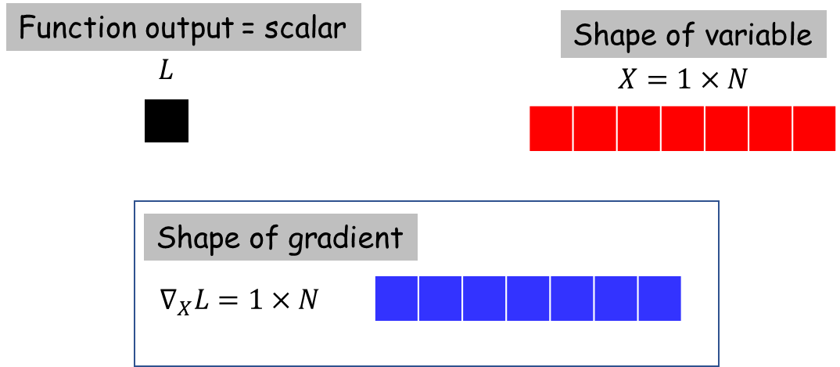
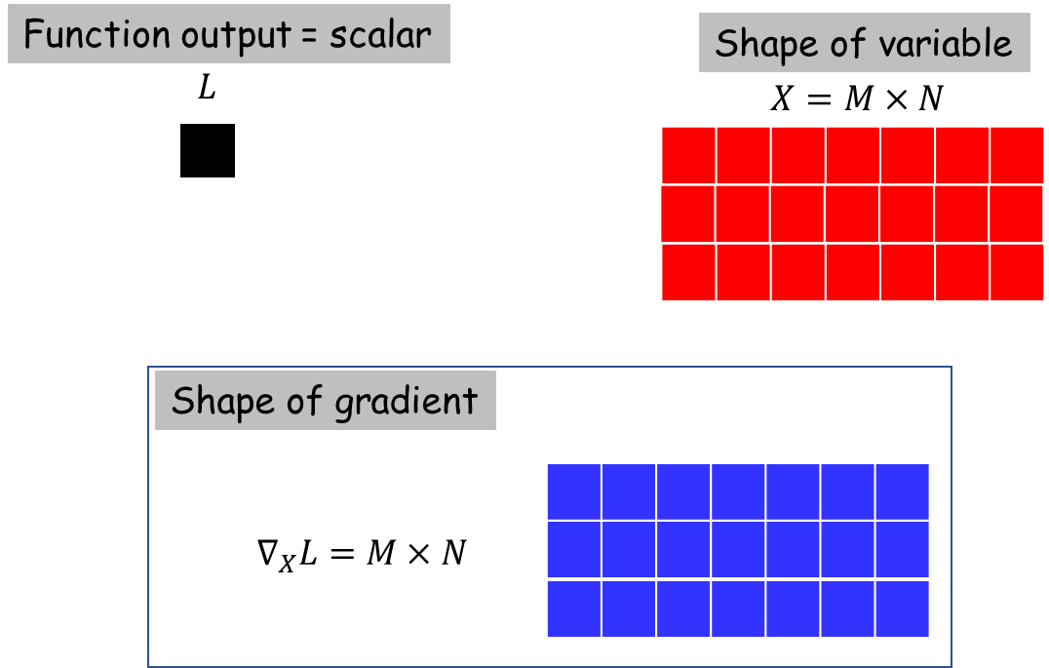
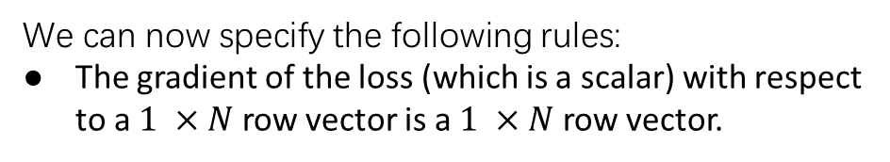
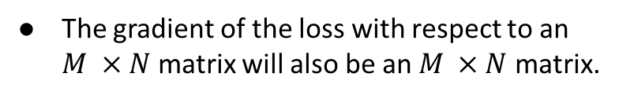
MLP Backward
Computing Derivatives
We can now specify the following rules:
The gradient of the loss (which is a scalar) with respect to a $1 ×N$ row vector is a $1 ×N$ row vector.
The gradient of the loss with respect to an $M ×N$ matrix will also be an $M ×N$ matrix.
The i-th component of $∇_{X}L$ is the partial derivative $\frac{∂L}{∂X_{i}}$.
The $(i,j)$th element of $∇_{X}L$ is the partial derivative $\frac{∂L}{∂X_{i,j}}$.

Slide 17
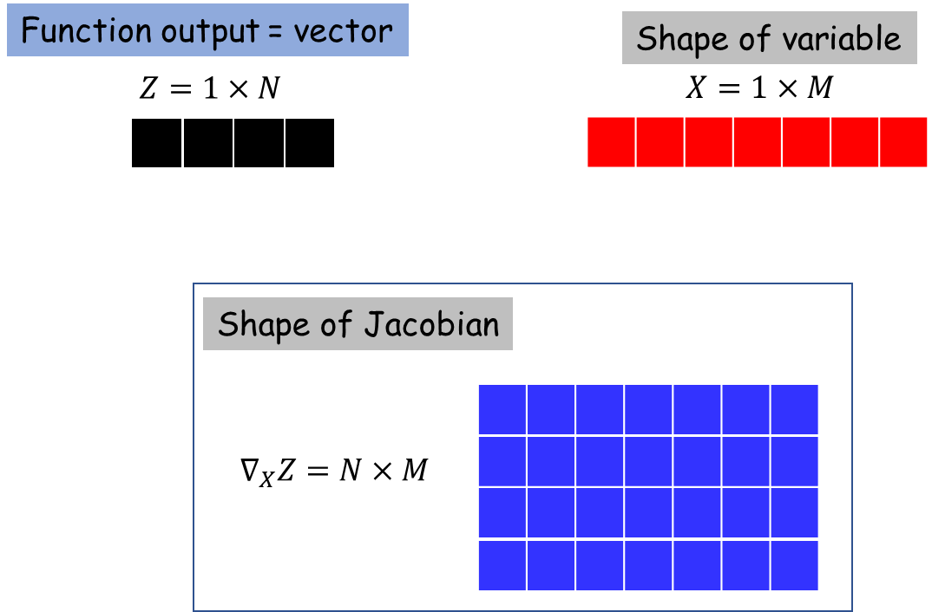
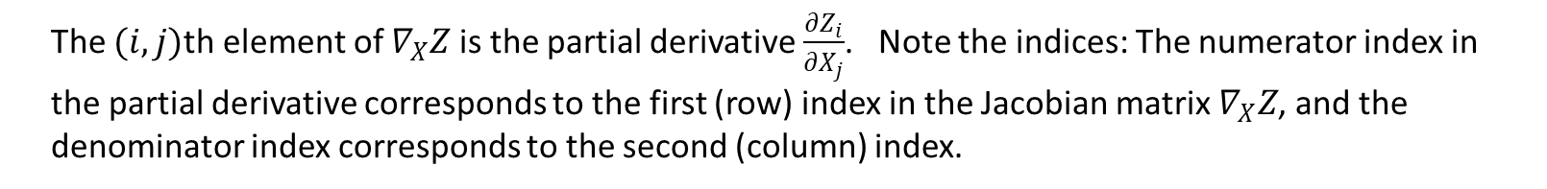
MLP Backward
Computing Derivatives
The Jacobian of a $1 ×N$row vector with respect to a $1 ×M$ row vector will be an $N ×M$ matrix.
The $(i,j)$th element of $∇_{X}Z$ is the partial derivative $\frac{∂Z_{i}}{∂X_{j}}$. Note the indices: The numerator index in the partial derivative corresponds to the first (row) index in the Jacobian matrix $∇_{X}Z$, and the denominator index corresponds to the second (column) index.

Slide 18
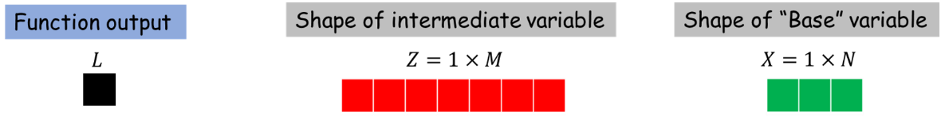
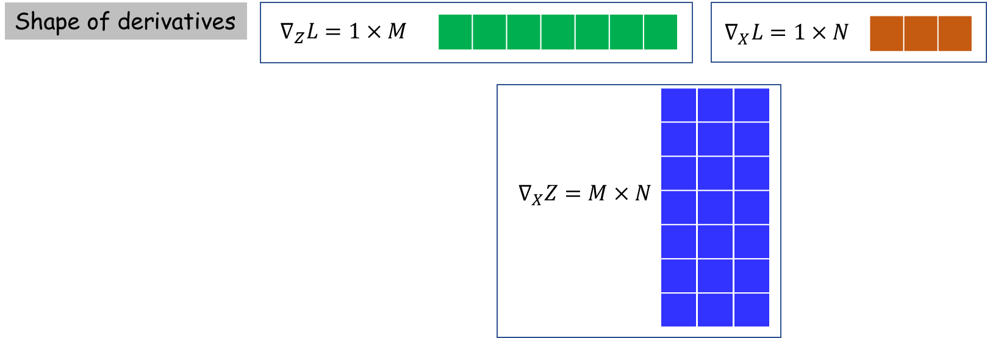
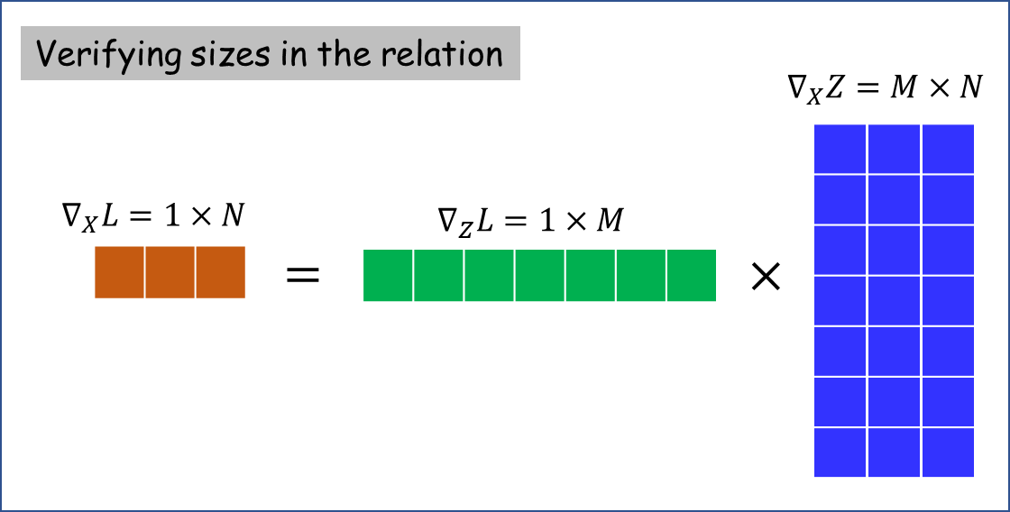
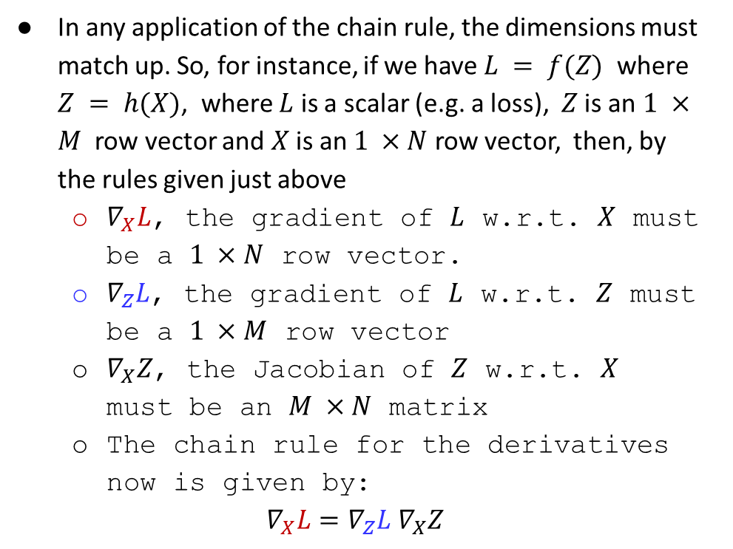
MLP Backward
Computing Derivatives
In any application of the chain rule, the dimensions must match up. So, for instance, if we have $L = f(Z)$ where $Z = h(X)$, where $L$ is a scalar (e.g. a loss), $Z$ is an $1 ×M$ row vector and $X$ is an $1 ×N$ row vector, then, by the rules given just above
$∇_{X}L$, the gradient of $L$ w.r.t. $X$ must be a $1 ×N$ row vector.
$∇_{Z}L$, the gradient of $L$ w.r.t. $Z$ must be a $1 ×M$ row vector
$∇_{X}Z$, the Jacobian of $Z$ w.r.t. $X$ must be an $M ×N$ matrix
The chain rule for the derivatives now is given by:
$$∇_{X}L=∇_{Z}L ∇_{X}Z$$
the shape of the loss derivative with respect to any network parameter or intermediate variable will be the transpose of their shapes.

Slide 19
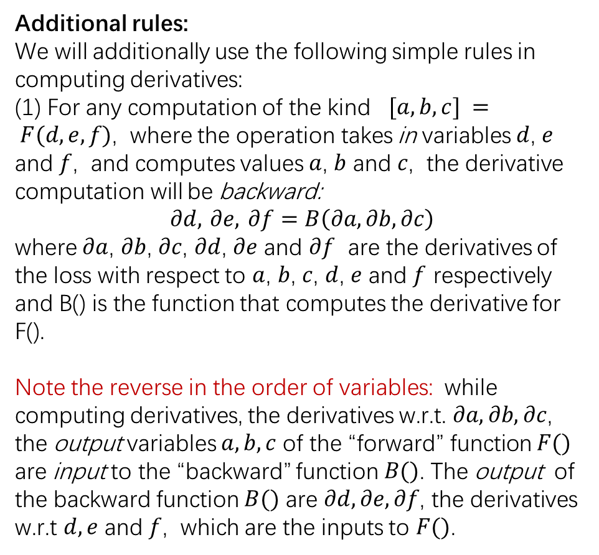
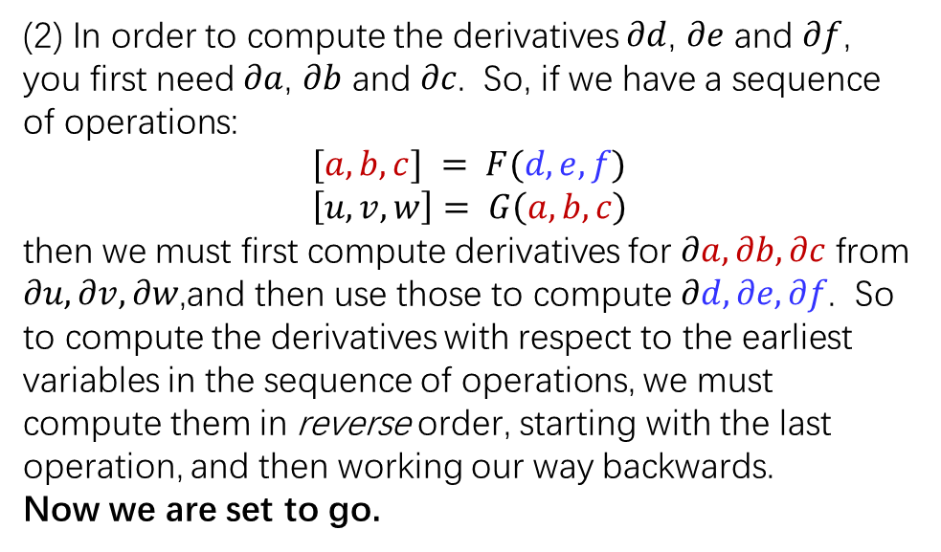
MLP Backward
Computing Derivatives
Additional rules:
We will additionally use the following simple rules in computing derivatives:
(1) For any computation of the kind $[a, b, c] = F(d, e, f)$, where the operation takes in variables $d$, $e$ and $f$, and computes values $a$, $b$ and $c$, the derivative computation will be backward:
$$∂d, ∂e, ∂f=B\left(∂a,∂b,∂c\right)$$
where $∂a$, $∂b$, $∂c$, $∂d$, $∂e$ and $∂f$ are the derivatives of the loss with respect to $a$, $b$, $c$, $d$, $e$ and $f$ respectively and B() is the function that computes the derivative for F().
Note the reverse in the order of variables: while computing derivatives, the derivatives w.r.t. $∂a,∂b,∂c$, the output variables $a,b,c$ of the “forward” function $F()$ are input to the “backward” function $B()$. The output of the backward function $B()$ are $∂d,∂e,∂f$, the derivatives w.r.t $d,e$ and $f$, which are the inputs to $F()$.
(2) In order to compute the derivatives $∂d$, $∂e$ and $∂f$, you first need $∂a$, $∂b$ and$∂c$. So, if we have a sequence of operations:
$$[a, b, c] = F(d, e, f)$$
$$\left[u,v,w\right]= G\left(a, b, c\right)$$
then we must first compute derivatives for $∂a,∂b,∂c$ from $∂u,∂v,∂w$,and then use those to compute $∂d,∂e,∂f$. So to compute the derivatives with respect to the earliest variables in the sequence of operations, we must compute them in reverse order, starting with the last operation, and then working our way backwards.
Now we are set to go.

Slide 20
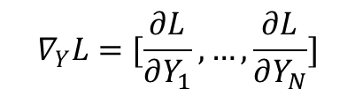

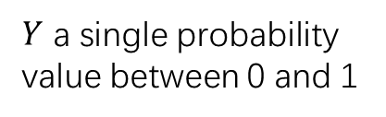



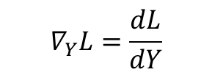
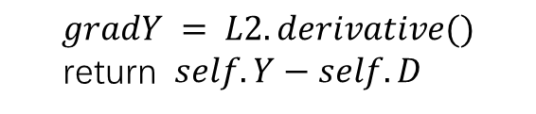

MLP Backward
The Gradient of the Loss
The loss is always a scalar
$$L = loss(Y, D)$$
$$∇_{Y}L$$
simple binary classifier or
simple regression
multi-class classification or vector regression
# of class
dim of the output prediction
$Y$ a single probability value between 0 and 1
$Y$ a scalar predicts
$Y$ will be a $1 ×N$ row vector
$$∇_{Y}L=\frac{dL}{dY}$$
$$∇_{Y}L=[\frac{∂L}{∂Y_{1}}, …,\frac{∂L}{∂Y_{N}}]$$
Implementation
$$gradY = L2.derivative()$$
return $self.Y−self.D$
$$∇_{Ylin}L=Y–D$$
L2 Loss
2) Softmax Cross-Entropy Loss
$$∇_{Y}L=Y–D$$
$$gradZ= softmaxCrossEntropy.derivative()$$
return $self.Y−self.D$
Notes:
(The variable is called gradZ in the code above to emphasize that it is the loss w.r.t. the input to the softmax)

Slide 21

MLP Backward
The Gradient of the Activation Layers
The typical activation layer has the form $Y = f(Z)$
$∇_{Z}L=∇_{Y}L ∇_{Z}Y$, where $∇_{Z}Y$ is the Jacobian of $Y$ w.r.t. $Z$
$$\frac{∂L}{∂Z_{i}}=\frac{∂L}{∂Y_{i}}f^{’}\left(Z_{i}\right) ∇_{Z}L=\left[\frac{∂L}{∂Z_{2}},\frac{∂L}{∂Z_{2}},⋯\right]$$
Implementation
You need to write functions of the kind:
gradZ = relu.derivative(gradY)
sigmoid.derivative()
tanh.derivative()
Internal implementation of the functions are shown on page 8 of slides, page 6 of writeup, and page 4 of ToyProblem

Slide 22




MLP Backward
The Gradient of a Linear Layer
$$∇_{X}L=∇_{Z}LW^{⊤}$$
$Z =XW + B$
$$∇_{W}L=X^{⊤}∇_{Z}L$$
$$∇_{B}L=∇_{Z}L$$
Implementation
gradX = linear.backward(gradZ)
Note that some of the terms in these equations are transposed with respect to the equations because we are now speaking of gradients rather than derivatives, and because we employ a row-vector notation for the vectors.
Notes:
Note that some of the terms in these equations are transposed with respect to the equations because we are now speaking of gradients rather than derivatives, and because we employ a row-vector notation for the vectors.

Slide 23
MLP Backward
Implementing the backward pass for a complete MLP
Loss = softmaxCrossEntropy(Y3, D)
Notes:
Note that some of the terms in these equations are transposed with respect to the equations because we are now speaking of gradients rather than derivatives, and because we employ a row-vector notation for the vectors.

Slide 24
MLP Backward
Implementing the backward pass for a complete MLP
Loss = softmaxCrossEntropy(Y3, D)
# First compute the gradient for the input to the final softmax layer
gradY3lin = softmaxCrossEntropy.derivative()
Notes:
Note that some of the terms in these equations are transposed with respect to the equations because we are now speaking of gradients rather than derivatives, and because we employ a row-vector notation for the vectors.

Slide 25
MLP Backward
Implementing the backward pass for a complete MLP
Loss = softmaxCrossEntropy(Y3, D)
# First compute the gradient for the input to the final softmax layer
gradY3lin = softmaxCrossEntropy.derivative()
# Compute the gradients past the preceding linear layer.
gradY2 = linear3.backward(gradY3lin)
Notes:
Note that some of the terms in these equations are transposed with respect to the equations because we are now speaking of gradients rather than derivatives, and because we employ a row-vector notation for the vectors.

Slide 26
MLP Backward
Implementing the backward pass for a complete MLP
Loss = softmaxCrossEntropy(Y3, D)
# First compute the gradient for the input to the final softmax layer
gradY3lin = softmaxCrossEntropy.derivative()
# Compute the gradients past the preceding linear layer.
gradY2 = linear3.backward(gradY3lin)
# The previous ReLu layer took in Y2lin and returned Y2. So…
gradY2lin = relu3.derivative()* gradY2
Notes:
Note that some of the terms in these equations are transposed with respect to the equations because we are now speaking of gradients rather than derivatives, and because we employ a row-vector notation for the vectors.

Slide 27
MLP Backward
Implementing the backward pass for a complete MLP
Loss = softmaxCrossEntropy(Y3, D)
# First compute the gradient for the input to the final softmax layer
gradY3lin = softmaxCrossEntropy.derivative()
# Compute the gradients past the preceding linear layer.
gradY2 = linear3.backward(gradY3lin)
# The previous ReLu layer took in Y2lin and returned Y2. So…
gradY2lin = relu3.derivative()* gradY2
# The preceding linear layer took in Y1 and output Y2lin
gradY1 = linear2.backward(gradY2lin)
Notes:
Note that some of the terms in these equations are transposed with respect to the equations because we are now speaking of gradients rather than derivatives, and because we employ a row-vector notation for the vectors.

Slide 28
MLP Backward
Implementing the backward pass for a complete MLP
Loss = softmaxCrossEntropy(Y3, D)
# First compute the gradient for the input to the final softmax layer
gradY3lin = softmaxCrossEntropy.derivative()
# Compute the gradients past the preceding linear layer.
gradY2 = linear3.backward(gradY3lin)
# The previous ReLu layer took in Y2lin and returned Y2. So…
gradY2lin = relu3.derivative()* gradY2
# The preceding linear layer took in Y1 and output Y2lin
gradY1 = linear2.backward(gradY2lin) # The preceding ReLU layer took in Y1lin and output Y1 gradY1lin = relu2.derivative()* gradY1
Notes:
Note that some of the terms in these equations are transposed with respect to the equations because we are now speaking of gradients rather than derivatives, and because we employ a row-vector notation for the vectors.

Slide 29
MLP Backward
Implementing the backward pass for a complete MLP
Loss = softmaxCrossEntropy(Y3, D)
# First compute the gradient for the input to the final softmax layer
gradY3lin = softmaxCrossEntropy.derivative()
# Compute the gradients past the preceding linear layer.
gradY2 = linear3.backward(gradY3lin)
# The previous ReLu layer took in Y2lin and returned Y2. So…
gradY2lin = relu3.derivative()* gradY2
# The preceding linear layer took in Y1 and output Y2lin
gradY1 = linear2.backward(gradY2lin) # The preceding ReLU layer took in Y1lin and output Y1 gradY1lin = relu2.derivative()* gradY1
# The preceding linear layer took in X and output Y1lin gradX = linear1.backward(gradY1lin)
Notes:
Note that some of the terms in these equations are transposed with respect to the equations because we are now speaking of gradients rather than derivatives, and because we employ a row-vector notation for the vectors.

Slide 30
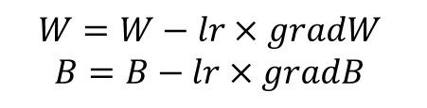

MLP Backward
Implementing the backward pass for a complete MLP
Optimization: As Loop
Update Parameters: Gradient Descent
# First compute gradients for the final linear layer logits & params gradYlin = softmaxCrossEntropy.derivative()
gradY2 = linear3.backward(gradYlin)
# We now wind down from the last-but-one layer down to the input for layer = num_hidden_layers-1 downto 1 gradYlin = ActivationLayers[layer].derivative()* gradY gradY = LinearLayers[layer].backward(gradYlin)
End
$$W=W−lr×gradW$$
$$B=B−lr×gradB$$
where $lr$is the learning rate.

Slide 31
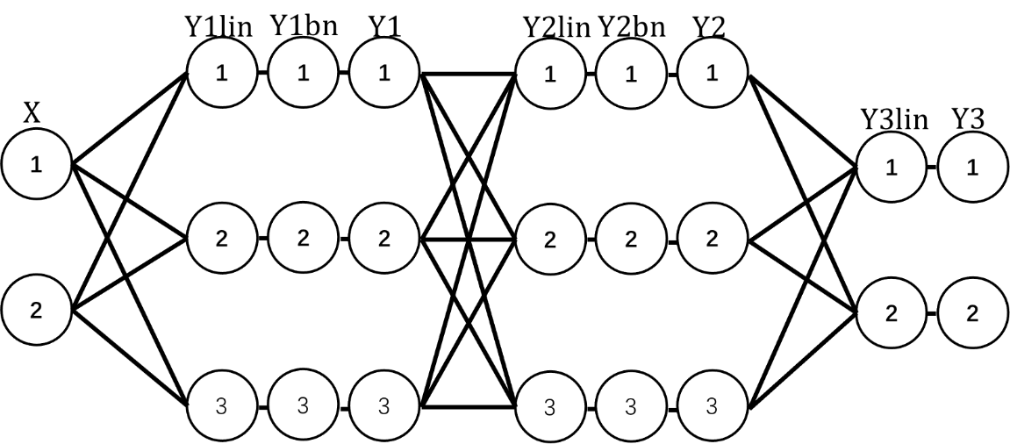
Batch Normalization
Batch Normalization Training Forward
will include batch norm at each of the hidden layers, updating our MLP as such:
Notes:
In the training phases, batch normalization layer first norms the inputs across the batch then apply the affine transformation on the normalized data.

Slide 32
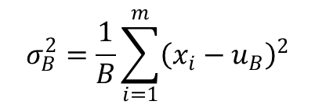

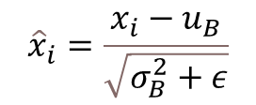
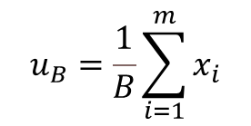
Batch Normalization
Batch Normalization Training Forward
two phases in forward operation: training and evaluation
Concept implementation
$$u_{B}=\frac{1}{B}\sum_{i=1}^{m}{x_{i}}$$
# First compute the mean of the input mean = np.mean(X, axis=0)
# Then compute the variance of the input
var = np.var(X, axis=0)
# Norm the input X using the mean and variance computed from above. Remember to add a small constant to avoid zero division.
norm = (X - mean)/sqrt(var + eps)
# Do the affine transformation
Y = norm * gamma + beta
# Update the running_mean and running_var, alpha is a scaler to control the updating speed.
running_mean = alpha * running_mean + (1 - alpha) * mean
running_var = alpha * running_var + (1 - alpha) * var
$$σ_{B}^{2}=\frac{1}{B}\sum_{i=1}^{m}{{\left(x_{i}−u_{B}\right)}^{2}}$$
$${\hat{x}}_{i}=\frac{x_{i}−u_{B}}{\sqrt{σ_{B}^{2}+ε}}$$
$$y_{i}=γ{\hat{x}}_{i}+β$$
Notes:
In the training phases, batch normalization layer first norms the inputs across the batch then apply the affine transformation on the normalized data.

Slide 33
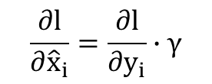
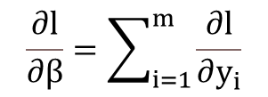
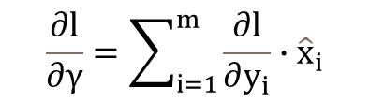
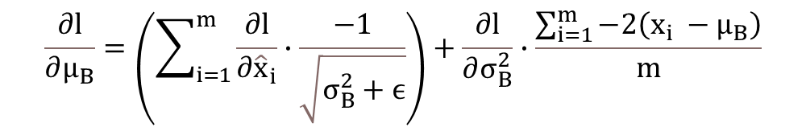
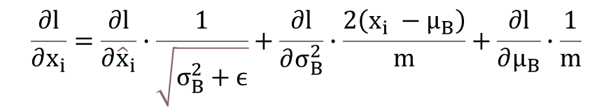
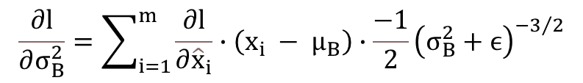
Batch Normalization
Batch Normalization Training Backward
Concept
$$\frac{∂l}{∂{\hat{x}}_{i}}=\frac{∂l}{∂y_{i}}∙γ$$
$$\frac{∂l}{∂μ_{B}}=\left(\sum_{i=1}^{m}{\frac{∂l}{∂{\hat{x}}_{i}}}∙\frac{−1}{\sqrt{σ_{B}^{2}+ϵ}}\right)+\frac{∂l}{∂σ_{B}^{2}}∙\frac{\sum_{i=1}^{m}{−2\left(x_{i} −{ μ}_{B}\right)}}{m}$$
$$\frac{∂l}{∂σ_{B}^{2}}=\sum_{i=1}^{m}{\frac{∂l}{∂{\hat{x}}_{i}}}∙\left(x_{i} − μ_{B}\right)∙\frac{−1}{2}{\left(σ_{B}^{2}+ϵ\right)}^{−3/2}$$
$$\frac{∂l}{∂x_{i}}=\frac{∂l}{∂{\hat{x}}_{i}}∙\frac{1}{\sqrt{σ_{B}^{2}+ϵ}}+\frac{∂l}{∂σ_{B}^{2}}∙\frac{2\left(x_{i} −{ μ}_{B}\right)}{m}+\frac{∂l}{∂μ_{B}}∙\frac{1}{m}$$
Update the gamma and beta with GD:
$$gamma=gamma−lr×gradGamma$$
$$\frac{∂l}{∂γ}=\sum_{i=1}^{m}{\frac{∂l}{∂y_{i}}∙{\hat{x}}_{i}}$$
$$\frac{∂l}{∂β}=\sum_{i=1}^{m}{\frac{∂l}{∂y_{i}}}$$
$$beta=beta−lr×gradBeta$$
Implementation
BN Backward function implementation details are shown on ToyProblem pages 27-28

Slide 34


Batch Normalization
Batch Normalization Inference Forward
Concept
$${\hat{x}}_{i}=\frac{x_{i}−u_{B}}{\sqrt{σ_{B}^{2}+ε}}$$
$$y_{i}=γ{\hat{x}}_{i}+β$$
Implementation
# Norm the input X using the running_mean and running_var computed from the training process.
norm = (X - running_mean)/sqrt(running_var + eps)
# Do the affine transformation, gamma and beta are 1xM row vectors.
Y = norm * gamma + beta

